Slide 1

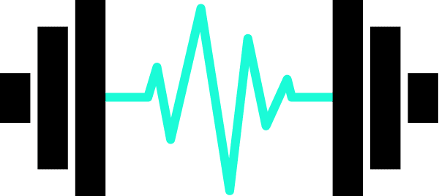
INSTITUTO SUPERIOR DE ENGENHARIA DE LISBOA Departamento de Engenharia Eletrónica e Telecomunicações e Computadores
Intelligent Sports Weights
Dissertação de Mestrado 2023/2024
Olga dos Santos Duarte
27675
Orientador: Prof. Dr. Rui Policarpo Duarte
Júri: Prof. Dr. Mário Véstias
03 2024
Notes:
Falar mais do TinyML
15min de apresentação

Slide 2
Presentation Outline
Introduction & Motivation
03
Objectives
04
Related Works on Movement Recognition
05
Solution Outline
06
No Code Platforms to train NN
07
Relevant Technologies
08
Ultra Low power embedded system - Comparison
09
Preliminary Results
10
Work Plan
12
Known Challenges and Limitations & Conclusions
13
Notes:
Related works on...
Platforms type (embebeded system platforms)
Relevant Tecnologies
System architecture - (software) - solution proposal

Slide 3
Introduction & Motivation
Build an embedded system using a microcontroller with a trained Neural Network.
Use of no code platform.
Program a neural network on low power microcontroller.
The use of TinyML.
01
02
03
Avoid Injury
Embedded Systems
Real time feedback
Autonomous system to identify the correctness of fitness exercises to avoid injury.
Embedded systems with compact sensor capabilities and low-power consumption.
Sensors in gym equipment to provide feedback on the correctness of exercise.
Notes:
After feeling comfortable with the results,
Descomplicar - no máximo colocar um 1,2 e 3
Build -> program/develop
Bullets:
Program a neural network on low power microcontroller
Low code
Este microcontrolador tem uma plataforma estilo no code que permite treinar uma rede neuronal e fazer o deployment diretamente no micro. Para ter uma experiência rápida de treino de rede, como é adeuqação com o nosso problema. Exploração da plataforma.​
Após ganhar confiança com a rede.​
Depois vamos fazer a aquisição de dados, temos uma rede implementada - o esqueleto – que será implementada em software. Para permitir fazer optimizações que a plataforma no code não irá permitir.​
​
Uma abordagem top-down.​
Ter a ferramenta da plataforma para agilizar a explicação do modelo da rede neuronal​
Depois "olear" isto desenvolvendo em software, começar por detectar movimentos numa rede já treinada - depois explorar nos movimentos aliados ao desporto.​
​
Edge impulse configuramos, mas não conseguimos optimizar –> procurar "comprovativo"

Slide 4
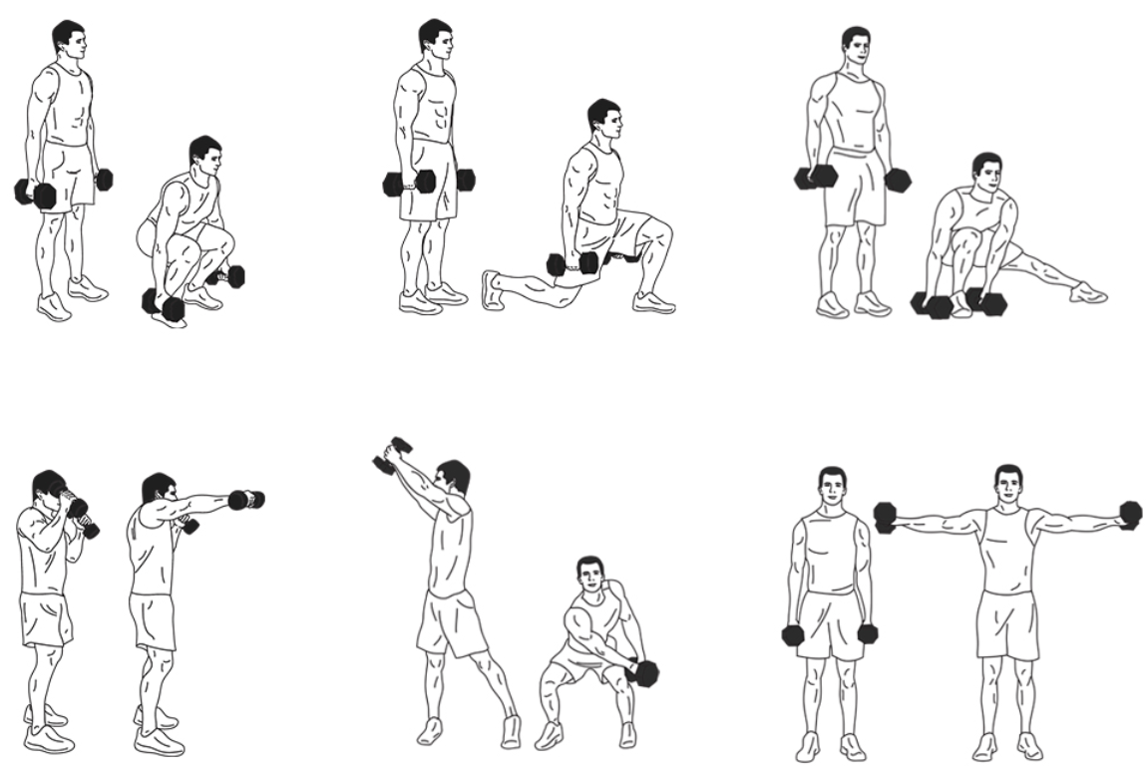
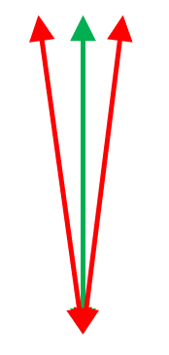
Objectives
01
Autonomy - Operate autonomously with a battery for more than 8h.
Key requirements
02
Compact Design – Compact and lightweight facilitating ease of use
during exercise and to be attached to gym equipment.
03
Real-time Data Acquisition - Capability to collect motion data using accelerometer data in real-time and communicate to a host device using BLE.
04
Training NN - Train a NN model with a custom dataset for different exercise movements and with correct and incorrect labels.
05
Classification - validate the movement via a trained NN.
06
Feedback - provide real-time feedback to the user.
Notes:
Partir em dois slides e reduzir o texto
4 – use built in AI accelerater
BLE basta sigla

Slide 5
Related Works on Movement Recognition
NNs for classification are gaining popularity among researchers and product developers, especially in movement detection and recognition.
01
Sports
Wearable sensors to detect moves, using the IMU signal processing methods to classify specific activities.
02
Machine Learning applied to Health
The use TinyML and emphasize the use of MCUs as the devices, allowing for processing closer to the sensing platform.
03
Neural Networks
Use classification based on a set of generic features that were calculated from the sensor data to determine movements recognition.
Notes:
Mudar imagem
Posso colocar apenas uma pequena descrição? Sim
Adicionar lista dos trabalhos analisados
Diminuir o texto
Simplificar

Slide 6
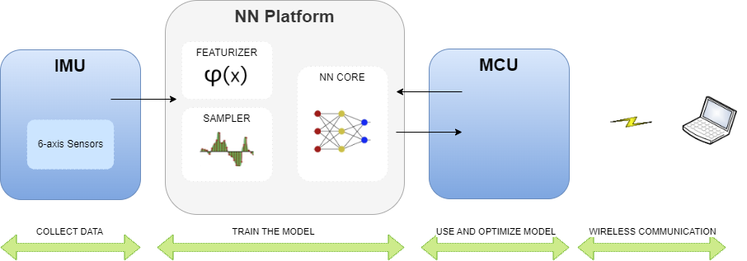
IMAGEM AINDA ESTÁ ERRADA
Solution Outline
Notes:
Problema a resolver
Esboço
Solution outline ( title)
IMU acc
MCU
RF/BLE
Antenas para ligar ao host (pc)
Plataforma resolve o que tinhamos para resolver -> solução completamente integrada
1 instância IMU para plataforma
2 – depois é que passa pelo acc
Diminuir texto
Detalhar o Seeed Studio XIAO nRF52840 Sense e os seus detalhes – fotografia
NN Platform - inferência
Explicar a solução
Embedded system for real-time motion recognition involves integrating an IMU, MCU and an OLED display.
The system collects motion data through the IMUs accelerometer. The MCU,
equipped with a NN implementation – previously trained, For training the NN, raw sensor data is transmitted to a computer - the host -via BLE - analyzes the motion data on-the-fly, categorizing movements as well or poorly executed, fast or slow, and correct or incorrect
trajectory. This information will be display using a LED or an OLED display,
depending on the equipment being used and the performed movement.

Slide 7
Platforms
Edge
Impulse
Google
Colab
No code platform.
Free development.
Automation capabilities to build valuable datasets for edge devices.
Integrates with small portable MCUs.
Uses TensorFlow Lite for training, optimizing, and deploying deep learning models to embedded devices.
No code platform.
Offers free access.
Designed to run ML models on MCUs and other devices with only few kilobytes of memory.
TensorFlow Lite can be use.
Notes:
Low code
Diminuir quantidade texto

Slide 8
Relevant Technologies
01
Accelerometer & Gyroscope
Acc detects linear acceleration of devices, that is, the acceleration along an axis. While gyro detects the angular velocity, i.e, how fast the body is turning.
02
Ultra-low power embedded system
Ultra-low power embedded systems can be small, low power, low cost and wireless, for the purpose of the project, the embedded system chosen has to measure
and report acceleration, orientation and other gravitational forces.
03
Bluetooth Low Energy
Wireless, low-power personal area network. Its goal is to connect devices over a relatively short range.
Notes:
Melhorar a imagem
Juntar acc e gyro

Slide 9
Ultra-low power embedded system Comparison​
 | NRF51 Sensor Tag | Seeed Studio XIAO nRF52840 Sense | CJMCU Beetle | Texas Instruments TIDC-CC2650STK-SENSORTAG
Advantages | Low cost, 3 axis Accelerometer Sensor, BLE 5.0, Low Power Consumption Bluetooth. | Low cost, Low Power, BLE 5, Great documentation, not expensive, easy to start use and program, IMU with extra capabilities - like pedometer. | Low-power and extended-range Capabilities. | Advanced debugging and profiling Tools.
Disadvantages | Excluded due to the lack of examples and public documentation. | Pay more for the connectivity | Doesn’t have built-in Bluetooth capabilities. | Excluded due to the size, price and the learning curve of the software use to Develop.
Notes:
Enviar o datasheet <---
Comunicar sintese do que fiz
Take points / "sell" message
Trabalho de pesquisa, e os ensaios

Slide 10

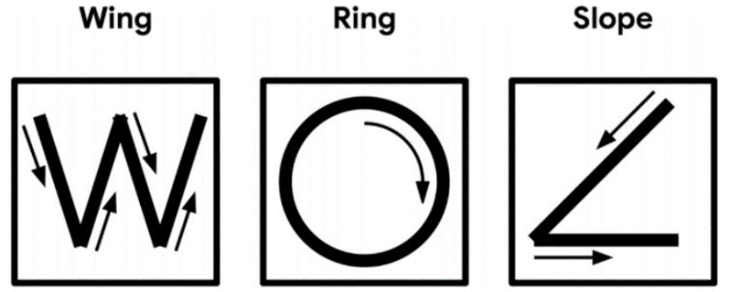
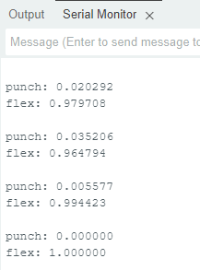
01
Preliminary Results​
Pedometer experience
Step counter, collecting the data from the sensor.
02
Magic Wand – Tiny ML
The goal was to analyze the 3-axis returns in different movements
03
Evaluation of TensorFlow Lite Using the Arduino Platform
Notes:
Resultados e conclusões
(gráficos)

Slide 11
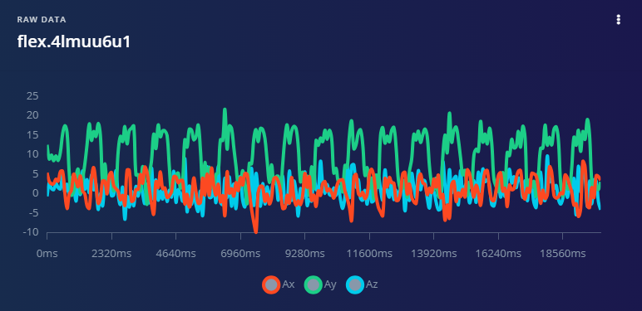
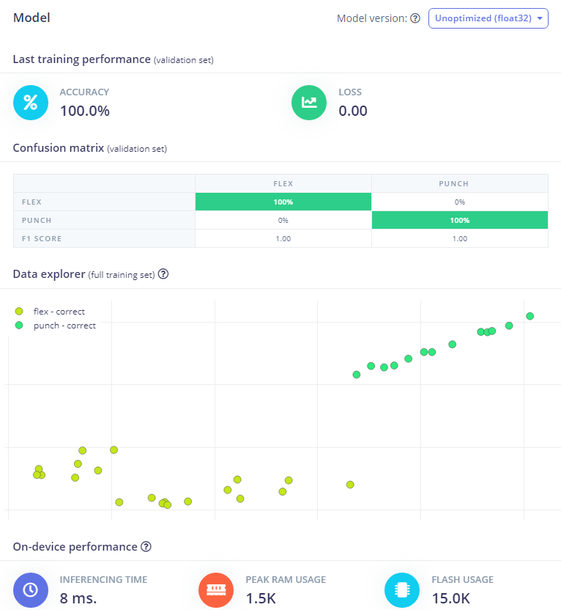
04
Preliminary Results​
Evaluation of TensorFlow Lite Using the Edge Impulse Platform
Notes:
Resultados e conclusões
(gráficos)

Slide 12
Work Plan
Notes:
Melhorar imagem

Slide 13
Known Challenges and Limitations
Challenges
Limitations
Program a NN to run on the selected MCU
Platforms used and the ability of optimize the results
Optimize the construction of the Model due to the limitations
Limited Storage
Improve battery usage
Limited RAM

Slide 14
Conclusions
Completar
The challenge for the this problem was accepted – Started by analyzing the state of the art and existing solutions and how I was going to compose my own.
Preliminary evaluation of the solution found.
Next Step: Programming of the network using TinyML (Tensor Flow).
Notes:
Foi aceite o desafio para o determinado problema e fui ver o estado da arte e soluções existentes e como ía compor a minha
Avaliação prelimiar da solução encontrada
Mas a ainda será feita a implementação da rede no micro, usando o tinyML (tensor flow)

Slide 15
THANK YOU!

Slide 16
Q&A

